Slide 1
Session 3
Examination techniques

Slide 2
Y11 Mantra
“Be selfish for my grade”

Slide 3
Practice questions
For helping with timing
Use past papers questions to test your understanding.
These are often found at the exam board website, together with the mark scheme, e.g. www.aqa.org.uk
Questions are often found in revision guides, but be careful they match the exam board and specification you do.

Slide 4
Revision means looking at something again; it does not mean looking at a new topic for the first time just before an exam.
Revision means you’ve already been to lessons, read the books, done the homework and now you’re looking at it again.

Slide 5
Dos- before the exam
Go to bed reasonably early
Make sure you know where your exam is
Arrive 10 minutes or so before exam
Don’t eat too much before exam
Make sure your pen etc is working
Bring a spare pen

Slide 6
STYLE OF QUESTIONS
A variety of question styles will be used such as:
  Multiple Choice
  Tick Box
  "Choose from a list"
  "Short answer"
  Those requiring description, explanation or discussion
  Longer open ended questions

Slide 7
COMMAND WORDS
Command words are used to instruct you on the type of answer expected from a question.
They are not used to trip you up but are designed to get the correct answer, therefore you need to understand what is required from different command words.
A variety of command words may be used.

Slide 8
COMMAND WORDS
Examples include:
  State/Give
  Outline
  Describe
  List
  Explain
The next slide explains these words

Slide 9
EXAM COMMAND WORDS
Make sure you understand what the question is asking you to do. It may be useful to underline the command word on the exam paper just so you’re clear what they are asking.
Command word
Account for Explain why something is the way it is.
Analyse Explain your view of why the main points of an idea, text or process are important. Do not just describe.
Calculate Show the method and obtain a numerical answer.
Compare Write about the differences and similarities.
Conclude Make a decision after thinking something through.
Contrast Show the differences between two things.
Criticise Analyses and make a judgement or give an opinion. Do not just be negative, give a considered view.
Define Give a brief explanation of what something means.
Describe Say what something or someone is like or give an account of events.
Discuss Explain the advantages and disadvantages of something, and give your opinion.
Evaluate Make a judgement about the quality of something, taking the evidence into account.
Explain Give reason WHY something is as it is or HOW it operates.
Give reasons for Explain using words like because to make clear WHY things happen.
Identify Point out the required features or reasons.
Interpret Explain what you understand to be the meaning, or what someone else intended the meaning to be.
Justify Give good reasons for.
Summarise Give the main points of an idea or an argument.

Slide 10
Tips for Answering Questions
  1. Read the question twice.
Q1. Give two ways customers could find out more about the activities shown in figure 1 (2 marks) .
READ it,
READ it again!

Slide 11
Tips for Answering Questions
2. Underline the command words and key words in the question before you start.
Q2. Describe the methods that were used to carry out an investigation of a leisure area
Q2. Describe the methods that were used to carry out an investigation of a leisure area

Slide 12
Tips for Answering Questions
3. Look at the number of marks available and think if it is possibly a mark per point or level answer.
Q3. Using figure 4, explain the factors which a family would need to consider when planning their route by car from Belgium to the lake district (6 marks)
Q3. What is meant by the tern in-bound tourist (2 marks)
This is worth 2 marks and so the examiner will be looking for a short straight forward answer. You will need to say two things.
This is worth 6 marks and so you will be expected to give a longer answer and it will be marked using levels. You are always aiming for the highest level and so should give the differences, explain them and give examples.

Slide 13
Tips for Answering Questions
4. Use the space given as a guide for how much to write.
Q4. What is a heritage coast (3 marks)
A place by the sea ______ ____________________________________________________________________________________________
Heritage coasts cover most undeveloped parts of the UK coastline. It is a national project which aims to protect unspoilt parts of the coastline from tourism. The Pembrokeshire coast is an example
This answer uses all the space and tries to say at least 3 things about the place for the 3 marks available.
This answer is clearly too short, lots of lines have been left empty.

Slide 14
Tips for Answering Questions
5. For longer questions take time to think and plan your answers (spider diagrams)
Shopping
Oxford street, covent garden
Q5. Chose one tourist town and describe a suggested programme for visitors to have an interesting day
Visit historic sites
Tower of London, Buckingham palace
Museums
e.g Science museum, British museum
London
Words in bold are the plan you would write!
Transport
use the underground, or ferry in docklands on Thames, or do a bus tour
Food
Go to the river and have food. Or take a picnic into Regents park

Slide 15

Tips for Answering Questions
Attempt every question.
If you are stuck on a question leave it and come back to it later.
Make a guess if all else fails (never leave blanks, you can’t lose marks for wrong answers but a guess may gain you some marks).
If you can’t remember all the details, write as many as you can and guess the rest.
Lucky guess!

Slide 16
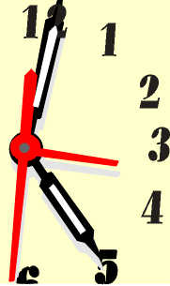

Tips for Answering Questions
Do not rush. People always finish early. It is better to plan and answer properly than make silly mistakes and then sit waiting for the end.

Slide 17
More Top Tips – Support in English
Support in English
Day-to-day effort in lessons is key.
Revision sessions after school.
CGP Revision Guides can be purchased.
Watch Mr. Bruff YouTube channel – it is amazing
Notes:
17

Slide 18
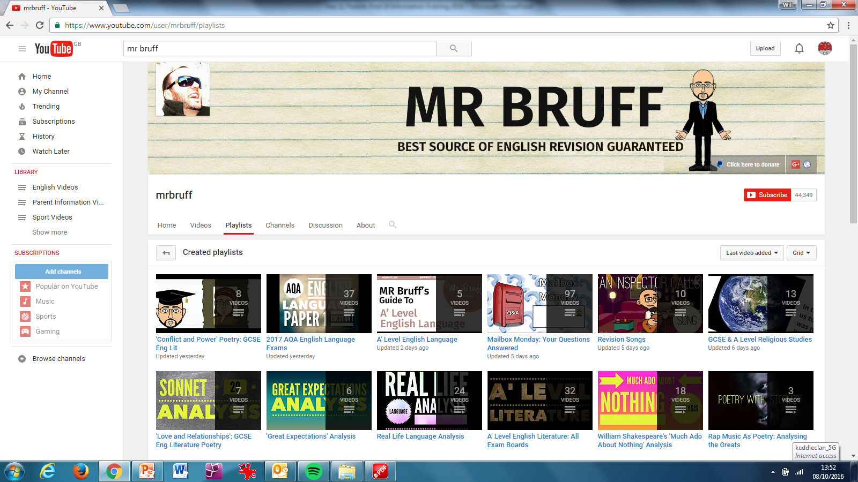
More Top Tips – Support in English
Notes:
18

Slide 19
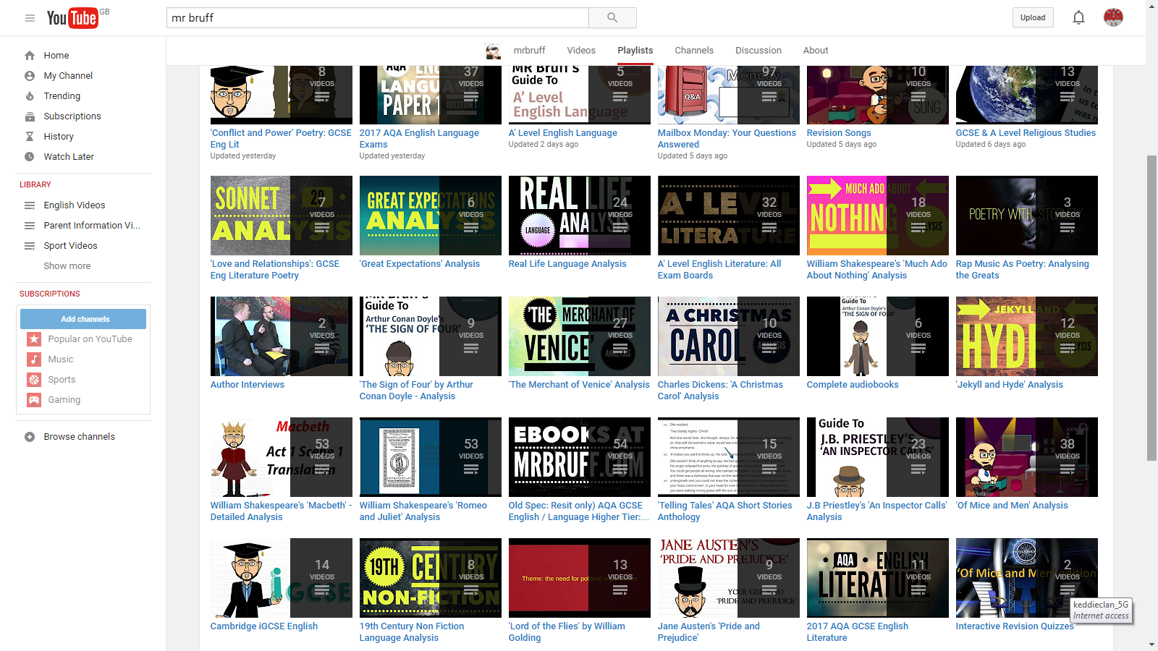
More Top Tips – Support in English
Notes:
19

Slide 20
Support in Maths
The best way to revise for Maths is by doing lots and lots of questions. The revision tactics that are used for other subjects [like taking notes or drawing mind maps] won’t work as well for Maths compared with doing lots of practice questions.
Little and often – STARTING NOW – will mean there isn’t much pressure in May and June.
Notes:
20

Slide 21
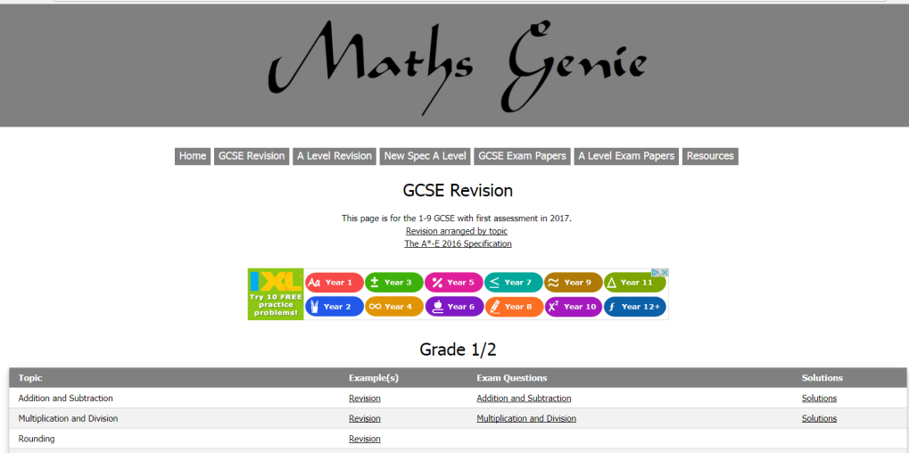
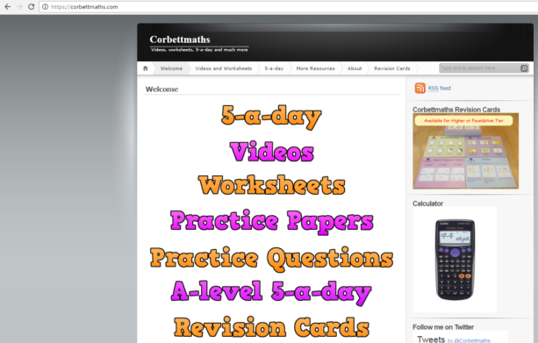
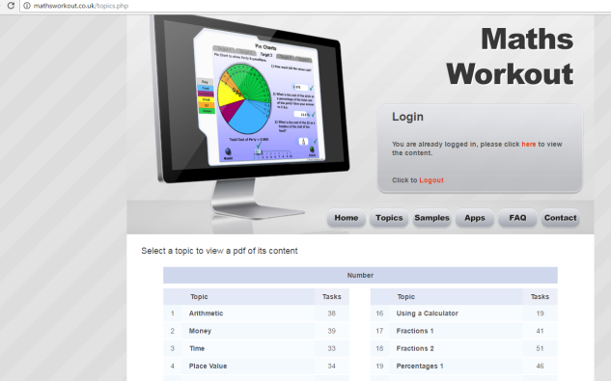
Key Maths websites
www.mathsgenie.co.uk – lessons on all topics
www.corbettmaths.com – 5-a-day activities, instructional videos for all skills.
www.mathsworkout.co.uk – Range of interactive activities on all topics.
Username: langley
Password: pattern
Notes:
21

Slide 22



Good body = Good mind
Eat healthy food
Drink plenty (water!!)
Get lots of rest

Slide 23
Fun
It’s vital when you are revising that you don’t get overworked, as this will lead to stress
Have a good balance between socialising, relaxing and working
Plan your revision sessions, and down time

Slide 24
Y11 Mantra
“Be selfish for my grade”

